Slide 1


BIOLOGY 2e
Chapter 35 NERVES AND NERVOUS SYSTEMS
PowerPoint Image Slideshow
This work is licensed under a Creative Commons Attribution-NonCommercial-ShareAlike 4.0 International License.

Slide 2
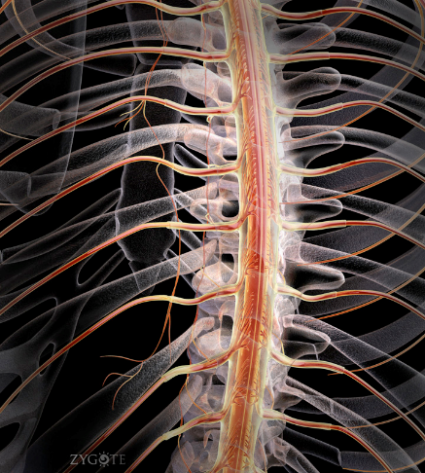
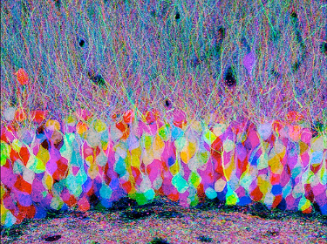
Nerves and Nervous Systems
A nervous system is an organism’s control center.
Tatiana Voza, PhD., tvoza@citytech.cuny.edu

Slide 3
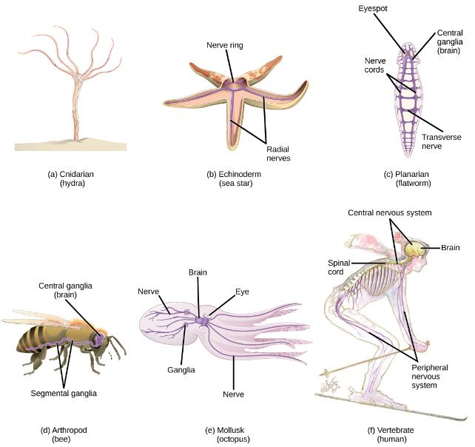
Evolution of the nervous system: Invertebrates
Hydras
  Nerve net: neurons in contact with one another and in contact with contractile epitheliomuscular cells
Planarians
  Ladder-like nervous system
  Cephalization - a concentration of ganglia and sensory receptors in the head
Annelids, Arthropods and Mollusks
  Complex animals
  True nervous systems

Slide 4
Human Nervous System
Division of Nervous System:
  Central nervous system (CNS)
    Includes the brain and spinal cord
    Lies in the midline of the body
  The peripheral nervous system (PNS)
    Contains cranial nerves and spinal nerves that:
      Gather info from sensors and conduct decisions to effectors
      Lies outside the CNS
Nervous system has three specific functions
  Receiving sensory input
  Performing integration
  Generating motor output

Slide 5
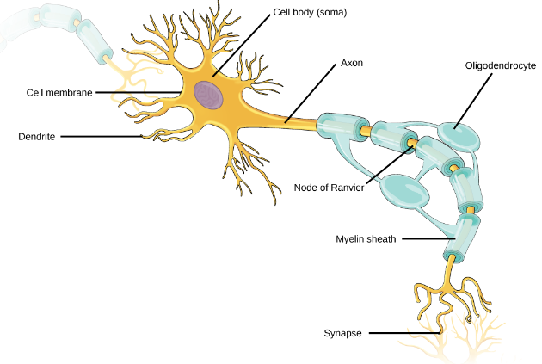
Nervous Tissue
Neurons
  Cell body contains nucleus
  Dendrites receive signals from sensory receptors and conduct toward the cell body.
  Axon conducts nerve impulses away from the cell body
    Covered by myelin sheath which increases speed of conduction. Demyelination (multiple sclerosis) will slow this rate.
    Any long axon is also called a nerve fiber

Slide 6
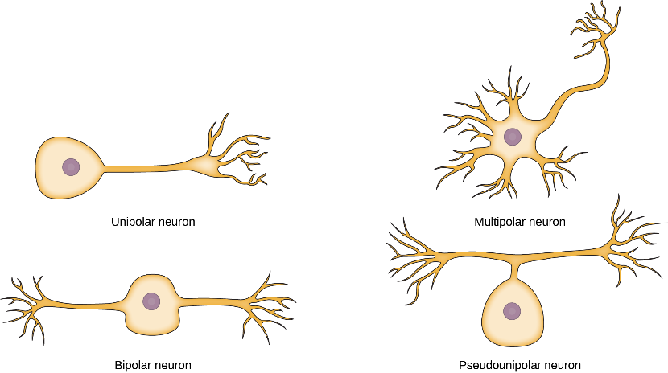
Types of Neurons
Four main types according to number & placement of axons and dendrites

Slide 7
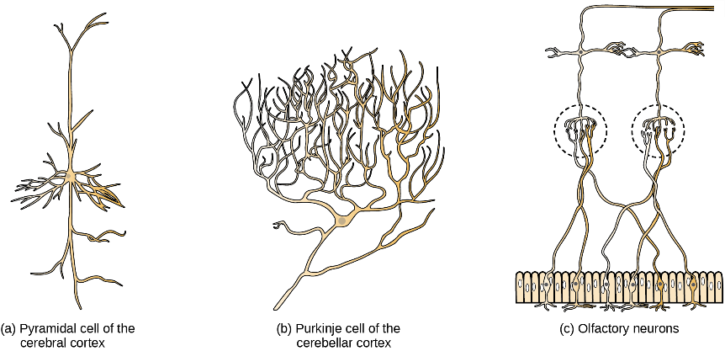
Types of Neurons
Diversity in size and shape: structure and function are linked

Slide 8
Types of Neurons
Sensory Neurons
  Accept impulses from sensory receptors
  Transmit them to the CNS
Motor Neurons
  Accept nerve impulses from the CNS
  Transmit them to muscles or glands
Interneurons
  Convey nerve impulses between various parts of the CNS

Slide 9
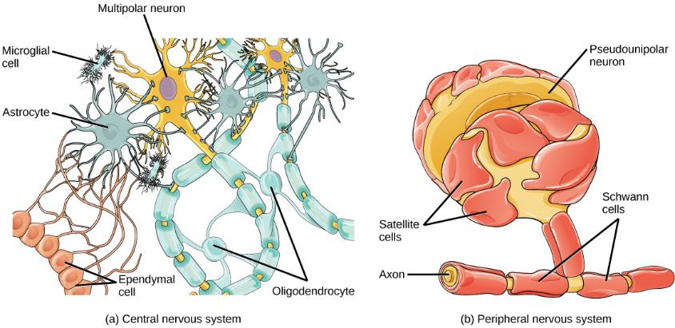
Glial Cells
Support, protect and nourish neurons (electrical wires)
Outnumber neurons (10 to 1) in the brain
Fulfill many vital functions (workers at the electric company)
Most brain tumors caused by mutations in glia

Slide 10
Glial Cells
In CNS:
Oligodendrocytes: form myelin sheath around axons
Astrocytes: provide nutrients and structural support; form the blood brain barrier
Ependymal cells: produce cerebrospinal fluid that cushions the neurons
Microglia: scavenge pathogens and dead cells
In PNS:
Schwann cells: form the myelin sheath
Satellite cells: provide nutrients and structural support to neurons.

Slide 11
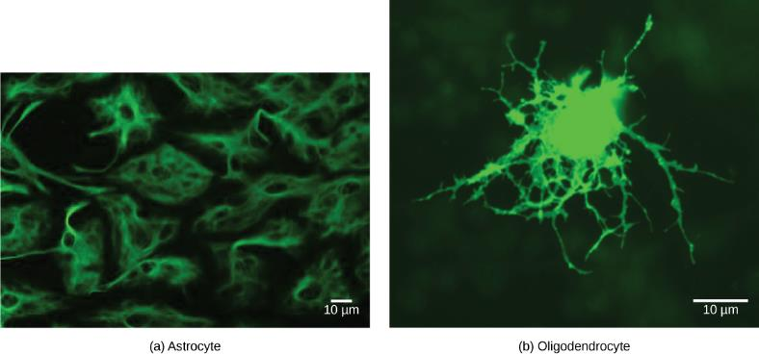
Glial cells: Figure 35.8
(a) Astrocytes and (b) oligodendrocytes are glial cells of the central nervous system. (credit a: modification of work by Uniformed Services University; credit b: modification of work by Jurjen Broeke; scale-bar data from Matt Russell)

Slide 12
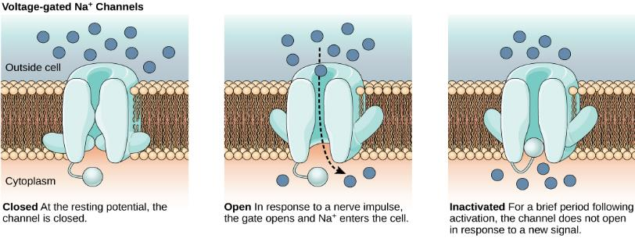
Neuron Communication
Signals are possible because each neuron has a charged cellular membrane (a voltage difference between the inside and the outside).
The charge of this membrane can change in response to neurotransmitter molecules released from other neurons and environmental stimuli.
At rest the outer portion of the cell membrane has an overall positive charge
At rest the inner portion of the cell membrane has an overall negative charge

Slide 13
Charged Membranes
Voltage-gated ion channels regulate the relative concentrations of different ions inside and outside the cell.
The difference in total charge between the inside and outside of the cell is called the membrane potential.

Slide 14
Resting Membrane Potential
The inside of a cell may be approximately 70 millivolts more negative than the outside (−70 mV)
Resting membrane potential is created and maintained by increasing the concentration of cations outside the cell (in the extracellular fluid) relative to inside the cell (in the cytoplasm).
The negative charge within the cell is created by the cell membrane being more permeable to potassium ion movement than sodium ion movement.

Slide 15
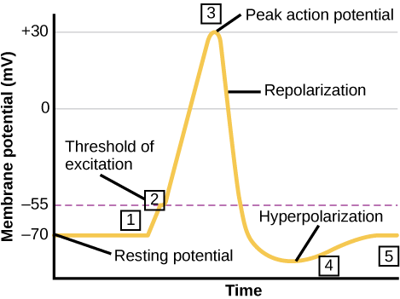
Membrane potential: Figure 35.11
The formation of an action potential can be divided into five steps: (1) A stimulus from a sensory cell or another neuron causes the target cell to depolarize toward the threshold potential. (2) If the threshold of excitation is reached, all Na⁺ channels open and the membrane depolarizes. (3) At the peak action potential, K⁺ channels open and K⁺ begins to leave the cell. At the same time, Na⁺ channels close. (4) The membrane becomes hyperpolarized as K⁺ ions continue to leave the cell. The hyperpolarized membrane is in a refractory period and cannot fire. (5) The K⁺ channels close and the Na⁺/K⁺ transporter restores the resting potential.

Slide 16
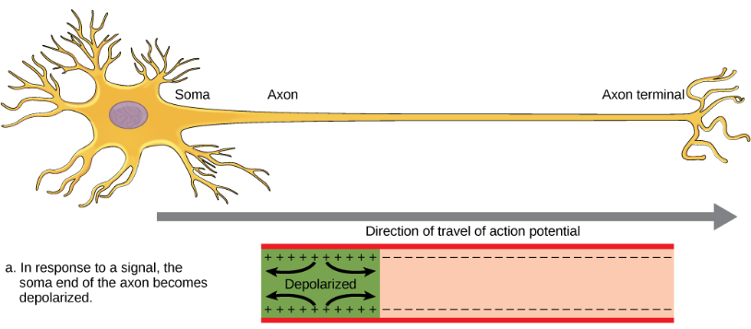
Action Potential
A stimulus from a sensory cell or another neuron depolarizes the target neuron to its threshold potential
Na+ channels in the axon hillock open, allowing positive ions to enter the cell.
Once the sodium channels open, the neuron completely depolarizes to a membrane potential of about +40 mV.

Slide 17
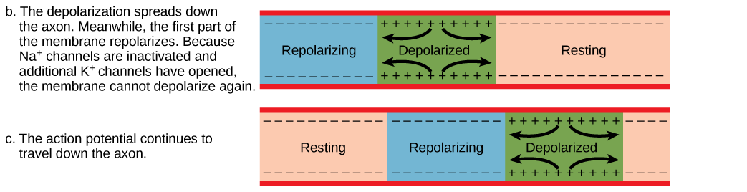
Action Potential
Action potentials are considered an "all-or nothing" event, in that, once the threshold potential is reached, the neuron always completely depolarizes.
Once depolarization is complete, the cell must now "reset" its membrane voltage back to the resting potential.

Slide 18
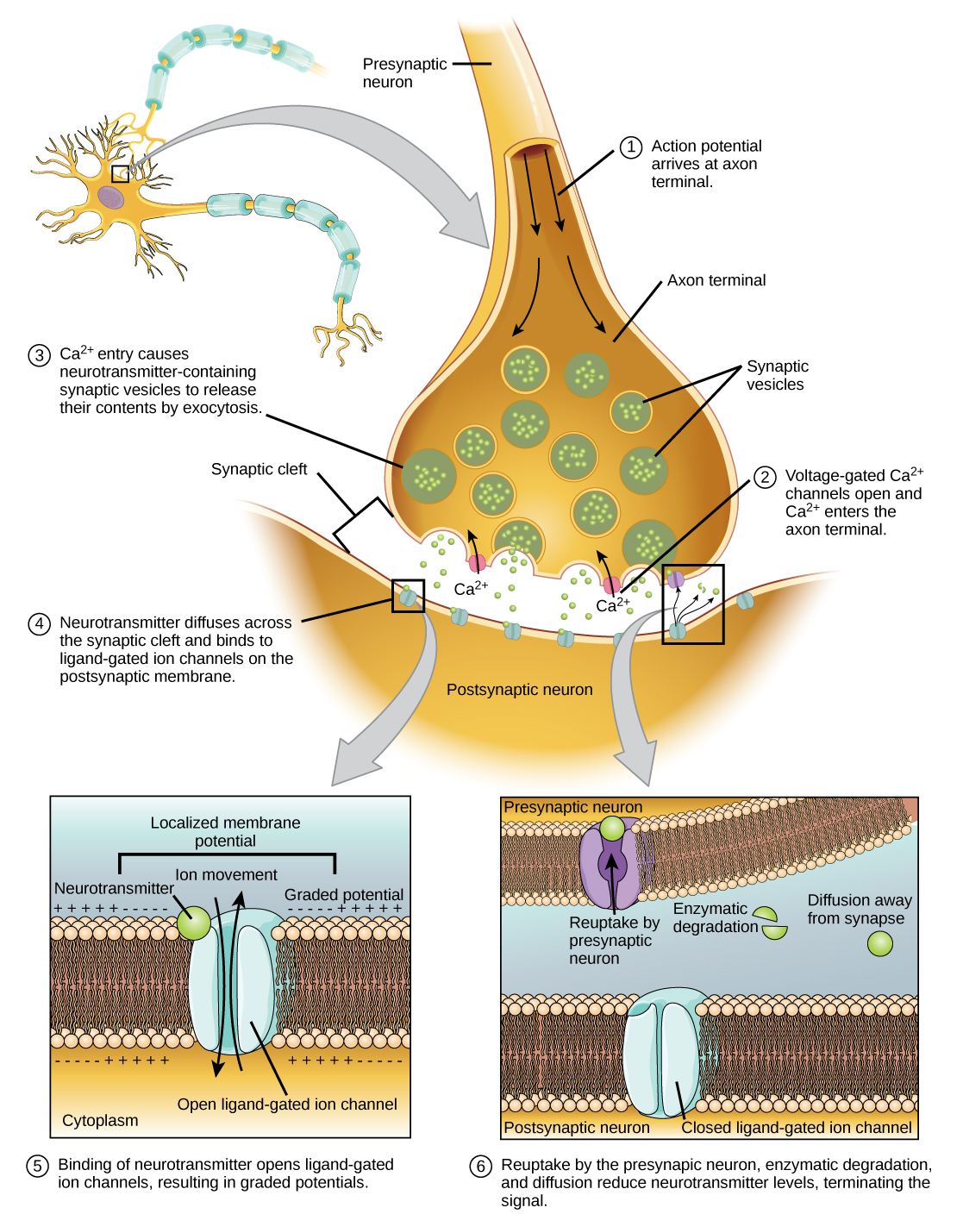
Chemical Synapse
Depolarization causes voltage-gated Ca²⁺ channels to open.
Calcium ions initiate a signaling cascade that causes synaptic vesicles, containing neurotransmitter molecules, to fuse with the presynaptic membrane.

Slide 19
Chemical Synapse
Fusion of a vesicle with the presynaptic membrane causes neurotransmitter to be released into the synaptic cleft.
Once neurotransmission has occurred, the neurotransmitter must be removed from the synaptic cleft so the postsynaptic membrane can “reset” and be ready to receive another signal.

Slide 20
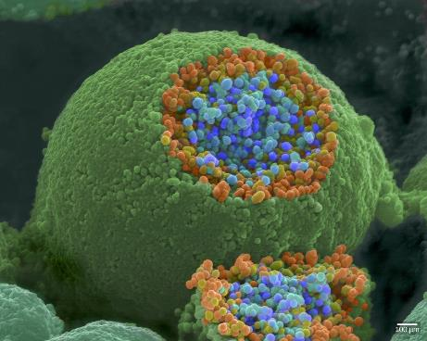
Chemical synapse: Figure 35.14
This pseudocolored image taken with a scanning electron microscope shows an axon terminal that was broken open to reveal synaptic vesicles (blue and orange) inside the neuron. (credit: modification of work by Tina Carvalho, NIH-NIGMS; scale-bar data from Matt Russell)

Slide 21
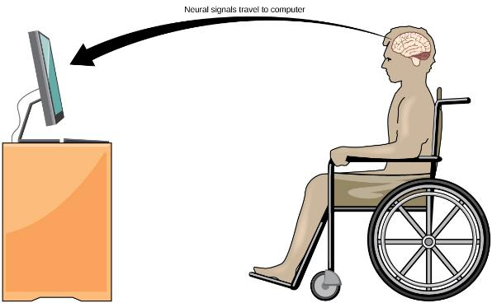
Brain-computer interface: Figure 35.17
With brain-computer interface technology, neural signals from a paralyzed patient are collected, decoded, and then fed to a tool, such as a computer, a wheelchair, or a robotic arm. VIDEO of woman using a brain controlled robotic arm.

Slide 22
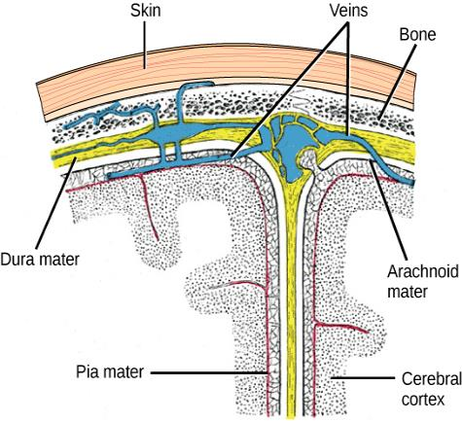
CNS: Brain and Spinal Cord
Spinal cord and brain are wrapped in three protective membranes, meninges
  Spaces between meninges are filled with cerebrospinal fluid
  Fluid is continuous with that of central canal of spinal cord and the ventricles of the brain

Slide 23
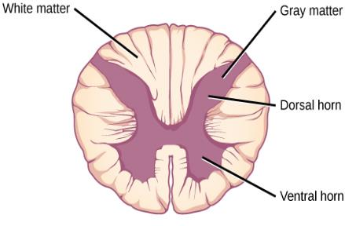
Spinal Cord
The spinal cord’s functions
  Center for many reflex actions
  Means of communication between the brain and spinal nerves
The spinal cord is composed of gray matter and white matter
  Cell bodies and short unmyelinated fibers give the gray matter its color
  Myelinated long fibers of interneurons running in tracts give white matter its color

Slide 24
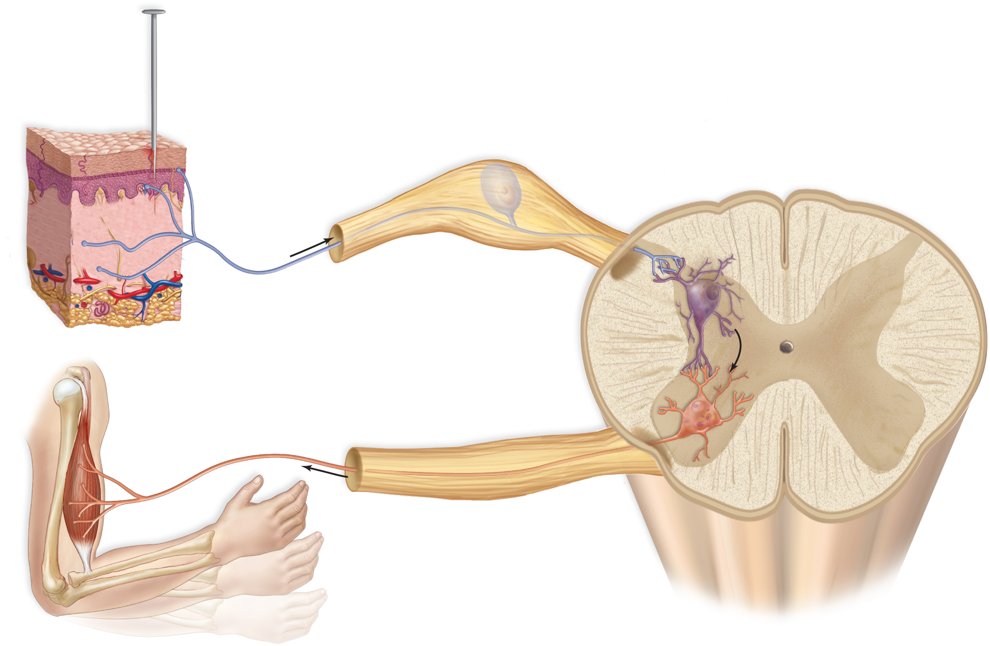
A Reflex Arc: the Path of a Spinal Reflex
pin
dorsal root ganglion
central canal
white matter
sensory
receptor
(in skin)
dendrites
Dorsal
gray matter
dorsal
horn
cell body of
sensory neuron
axon of sensory neuron
interneuron
dendrites
axon of motor neuron
cell body of
motor neuron
effector
(muscle)
ventral root
ventral horn
Ventral

Slide 25
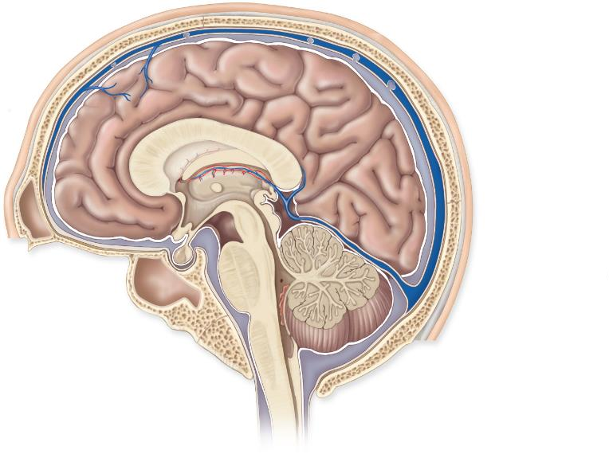
The Human Brain
Cerebrum
(telencephalon)
opening to lateral
ventricle
third ventricle
skull
Diencephalon
meninges
thalamus
(surrounds the
third ventricle)
corpus
callosum
hypothalamus
pineal gland
pituitary gland
fourth ventricle
Brain stem
midbrain
Cerebellum
pons
medulla
oblongata
spinal cord
a. Parts of brain

Slide 26
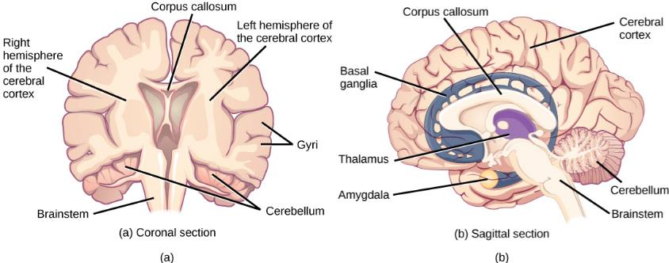
The Human brain: Figure 35.20
These illustrations show the (a) coronal and (b) sagittal sections of the human brain.

Slide 27

The Brain
Cerebrum is the largest portion of the brain in humans
  Communicates with, and coordinates the activities of, the other parts of the brain
  Longitudinal fissure divides into left and right cerebral hemispheres

Slide 28
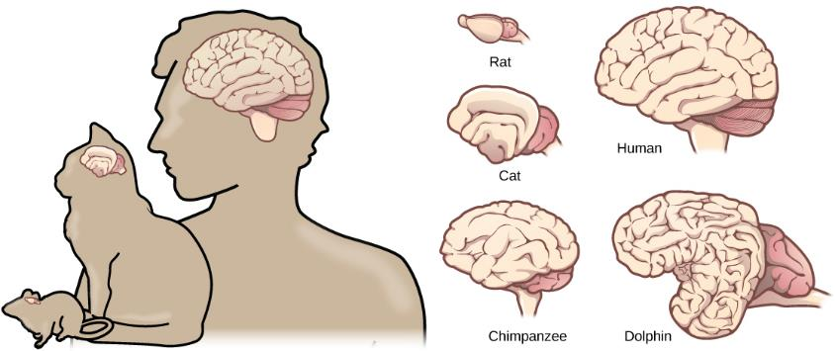
Cerebral Cortex
A thin but highly convoluted outer layer of gray matter
Covers the cerebral hemispheres
Contains motor areas and sensory areas as well as association areas

Slide 29
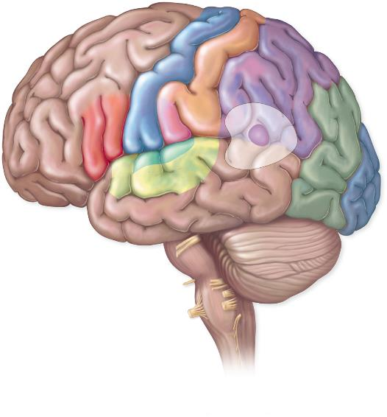
The Lobes of a Cerebral Hemisphere
central sulcus
Parietal lobe
Frontal lobe
primary motor area
primary somatosensory area
premotor area
leg
somatosensory
association area
motor speech
(Broca’s) area
trunk
primary taste area
arm
prefrontal
area
hand
general interpretation area
face
tongue
Occipital lobe
primary
visual area
lateral sulcus
visual
association
area
Temporal lobe
auditory association area
primary auditory area
sensory speech (Wernicke’s) area

Slide 30
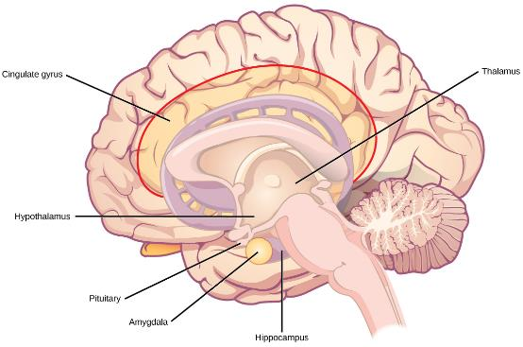
Diencephalon
Consists of hypothalamus and thalamus
  Hypothalamus controls the endocrine system via the pituitary; thermostat
  Thalamus is the gateway to and from the cortex
Pineal gland
  Also located in the diencephalon
  Secretes melatonin which helps to maintain circadian rhythm

Slide 31
Cerebellum & Brain Stem
Cerebellum
  Receives sensory input from the eyes, ears, joints, and muscles; sends motor impulses out the brain stem to the skeletal muscles. Balance and coordination
Brain stem = midbrain, the pons & medulla oblongata
  Midbrain
    Acts as a relay station for tracts passing between
      The cerebrum, and
      The spinal cord or cerebellum
  Pons
    Helps regulate breathing and head movements
  Medulla oblongata
    Contains reflex centers for vomiting, coughing, sneezing, hiccupping, and swallowing

Slide 32
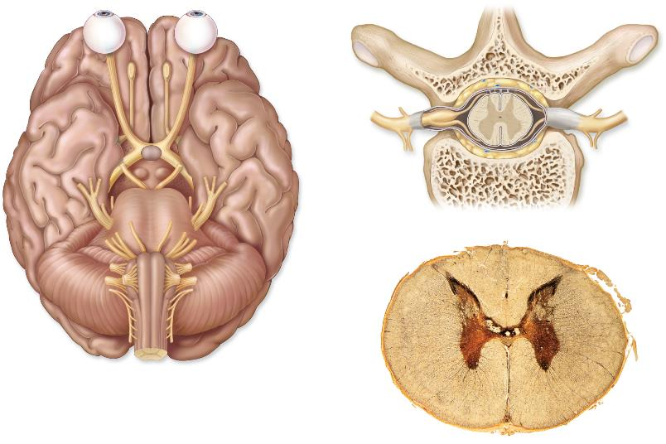
Peripheral Nervous System
Somatic system
  Contains cranial nerves and spinal nerves
    Gather info from sensors and conduct decisions to effectors
    Controls the skeletal muscles
  Conscious of its activity
spinal cord
gray matter
vertebra
white matter
frontal lobe
olfactory bulb
dorsal root
olfactory tract
dorsal root
ganglion
optic nerve
optic chiasma
spinal
nerve
ventral root
vertebra
b.
temporal lobe
central canal
cerebellum
gray matter
medulla
a.
white matter
c.

Slide 33
Peripheral nervous System
Autonomic system
Regulates activity of cardiac and smooth muscle, and glands
Unaware of its actions
Divided into sympathetic and parasympathetic
  Function automatically and usually in an involuntary manner
  Innervate all internal organs
  Utilize two neurons and one ganglion for each impulse
Sympathetic division
  Especially important during fight or flight responses
  Accelerates heartbeat and dilates bronchi
Parasympathetic division
  Promotes all internal responses associated with a relaxed state
  Rest and digest
  Promotes digestion and retards heartbeat

Slide 34
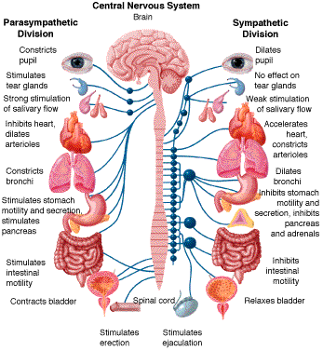
Autonomic System

Slide 35
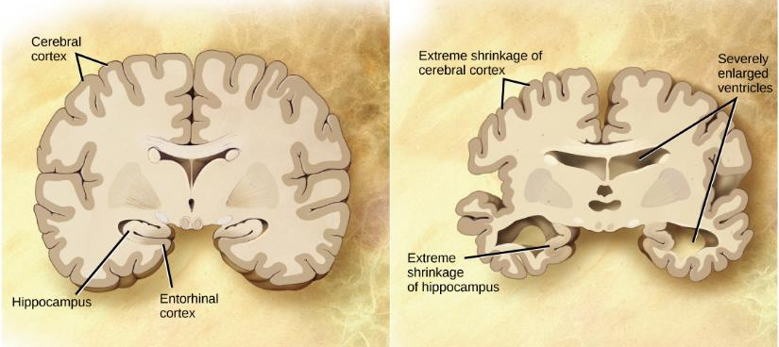
Nervous system disorders
Millions of patients in the United States
Neurodegenerative disorders include Alzheimer’s disease, Huntington’s disease, amyotrophic lateral sclerosis, and Parkinson’s disease.
Alzheimer’s is the most common form of dementia
Compared to a normal brain (left), the brain from a patient with Alzheimer’s disease (right) shows a dramatic neurodegeneration, particularly within the ventricles and hippocampus. (credit: modification of work by “Garrando”/Wikimedia Commons based on original images by ADEAR: “Alzheimer's Disease Education and Referral Center, a service of the National Institute on Aging”)

Slide 36
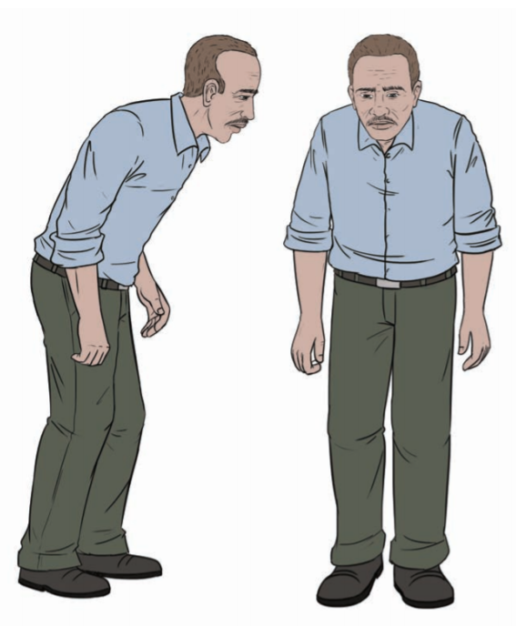
Nervous system disorders
Parkinson’s disease
  Loss of dopamine neurons in the substantia nigra that regulates movement
  Symptoms include tremor, slowed movement, speech changes, balance and posture problems
  Lewy bodies, which are abnormal protein clumps, are found in the brain
Parkinson’s patients often have a characteristic hunched walk.

Slide 37
Nervous system disorders
Neurodevelopmental
  Autism has characteristic of impaired social skills
    One of five mental disorders that the National Institute of Mental Health has determine to have a genetic etiology.
    No link to vaccines – 1998 report by Andrew Wakefield was retracted when he admitted that he falsified the data. He was stripped of his medical license for lying.
  Attention deficit hyperactivity disorder
    One of five mental disorders that the National Institute of Mental Health has determine to have a genetic etiology.

Slide 38
Nervous system disorders
Mental illness
  1 in 17 people which is about 12.5 million Americans
  Described in the Diagnostic and Statistical Manual of Mental Disorders
    Schizophrenia is the inability to differentiate between reality and imagination. Hallucinations are common.
    Depression affects about 6.7% of adult Americans annually
Other neurological disorders
  Epilepsy which is characterized by seizures.
  Stroke occurs when blood fails to reach a part of the brain.

