Slide 1
BIOLOGY 2E
Chapter 36 SENSORY SYSTEMS
PowerPoint Image Slideshow
This work is licensed under a Creative Commons Attribution-NonCommercial-ShareAlike 4.0 International License.

Slide 2
SENSATION
Senses convert a stimulus (such as light, or sound, or the position of the body) into an electrical signal in the nervous system.
This process is called sensory transduction.

Slide 3
36.1: SENSORY PROCESSES
The senses provide information from both the internal and external environment.
Provides information needed to maintain homeostasis and to interact with the outside world.

Slide 4
TYPES OF SENSATION
Olfaction (smell)
Gustation (taste)
Equilibrium (balance and body position)
Vision
Hearing
Electroreception
Magnetoreception
Somatosensation
Vestibular sensation: spatial orientation and balance,
Proprioception: position of bones, joints, and muscles)
Kinesthesia: limb movement and tracking

Slide 5
SENSORY TRANSDUCTION OVERVIEW
Stimulus
Reception – Activation of sensory receptors
Ion Channels Affected – Changes in Electrical Potential
Positive change in membrane potential depolarizes the neuron
Negative change hyperpolarizes the neuron
Called receptor potentials (sensory receptors)
If polarization change is sufficient (crossing a threshold), neuron will fire.

Slide 6
SENSORY TRANSDUCTION

Slide 7
ENCODING AND TRANSMISSION OF SENSORY INFORMATION
Type of stimulus
Location of the stimulus in the receptive field
Duration of the stimulus
Relative intensity of the stimulus
Encoding is preserved allowing brain to distinguish the type of stimulus
Intensity is encoded by:
Rate of action potentials (frequency)
Number of receptors activated (population)

Slide 8
PERCEPTION
Individual’s interpretation of a sensation
Occurs in the brain
All sensory signals (except from olfaction) are routed through the thalamus to the appropriate region of the cerebral cortex.
The overall process of perception between individuals of the same species is very similar.
Discrete differences amongst individuals do occur. (example: pain tolerance)

Slide 9
PERCEPTION
In humans, with the exception of olfaction, all sensory signals are routed from the (a) thalamus to (b) final processing regions in the cortex of the brain. (credit b: modification of work by Polina Tishina)

Slide 10
36.2: SOMATOSENSATION
Mixed sensory category
All sensations received from the skin and mucous membrane (tactile sense or touch)
Layers of the skin
Epidermis: keratin-filled cells, highly protective
Dermis: blood vessels, sweat and oil glands, lymph vessels, hair follicles
Hypodermis: adipose tissue (fatty layer), blood vessels, connective tissue, axons of sensory neurons

Slide 11
MAMMALIAN SKIN
Mammalian skin has three layers: an epidermis, a dermis, and a hypodermis. (credit: modification of work by Don Bliss, National Cancer Institute).

Slide 12
RECEPTOR TYPES
Thermoreceptors
Pain receptors
Chemoreceptors
Mechanoreceptors
Tactile
Merkel’s disks, Meissner’s corpuscles, Ruffini endings, Pacinian corpuscles, Krause end bulbs
Proprioceptors
Baroreceptors

Slide 13
RECEPTOR TYPES IN SKIN
Merkel’s disks, which are unencapsulated, respond to light touch.
Meissner’s corpuscles respond to touch and low-frequency vibration.
Ruffini endings detect stretch, deformation within joints, and warmth.
Pacinian corpuscles detect transient pressure and high-frequency vibration.
Krause end bulbs detect cold.

Slide 14
MEISSNER CORPUSCLES
Meissner corpuscles in the fingertips, such as the one viewed here using bright field light microscopy, allow for touch discrimination of fine detail. (credit: modification of work by “Wbensmith”/Wikimedia Commons; scale-bar data from Matt Russell)

Slide 15
PACINIAN CORPUSCLES
Pacinian corpuscles, such as these visualized using bright field light microscopy, detect pressure (touch) and high-frequency vibration. (credit: modification of work by Ed Uthman; scale-bar data from Matt Russell)

Slide 16
PROPRIOCEPTORS AND BARORECEPTORS
Proprioceptors
Muscle spindles
Detect stretch of muscles
Golgi tendon organs
Detect tension or force of contractions
Unconscious signals go through the cerebellum rather than the thalamus
Baroreceptors
Detect pressure changes within an organ (carotid artery, aorta, lungs)

Slide 17
INTEGRATION OF SIGNALS FROM MECHANORECEPTORS
Multiple receptors working together produce refined sense of touch
Nociceptors near surface
Fine touch receptors in upper layers (Merkel and Meissner)
Deep touch in lower layers (Pacinian and Ruffini)
Both the primary somatosensory cortex and secondary cortical areas are involved in integration and perception.
Touch receptors tend to be denser in glabrous skin

Slide 18
THERMORECEPTORS
Krause end bulbs: detect cold
Ruffini endings: detect warmth
Cold receptors on some free nerve endings
Thermoreceptors in dermis, skeletal muscles, liver, and hypothalamus
Run through the thalamus to primary somatosensory cortex
Intense temperatures can be perceived as pain since it runs along the same pathway as pain sensations

Slide 19
PAIN RECEPTORS AND CHEMORECEPTORS
Pain receptors
Pain = nociception
Caused by sources of injury/tissue damage
Some stimuli can mimic action of damaging stimuli (ex: capsaicin)
Pain is perception and starts in the brain
Pathways can run through the thalamus to the cerebral cortex
Some can go directly to the hypothalamus (ex: fight or flight response)
Chemoreceptors
Stimulated by specific chemicals

Slide 20
36.3: TASTE AND SMELL
Taste = gustation
Sweet substances tend to have high caloric value
Bitterness can be associated with toxicity
Sourness can be associated with spoiled food
Salty foods are valuable in maintaining homeostasis (ex: blood solute concentrations)
Savory foods tend to be high in protein
Smell = olfaction
Identify presence of food, other animals, or chemicals in the environment
Very interconnected because both involve molecules bonding to receptors.

Slide 21
TASTE AND ODORS
Stimuli are molecules taken in from the environment
Only molecules that are released into the environment and have an accompanying olfactory receptor can be “smelled”
Olfaction in humans
About 350 olfactory receptor subtypes work in combinations to produce about 10,000 different odors (Mice have about 1300 olfactory receptors)
Molecules will stimulate specific chemoreceptors
Taste and smell work together to create the perception of flavor

Slide 22
RECEPTION AND TRANSDUCTION
Odorants = odor molecules
Enter nose and dissolve in the olfactory epithelium (mucosa containing olfactory receptors at the back of the nasal cavity)
Olfactory receptors are dendrites of specialized neurons that bind to odorants
Neurons will send impulses directly to the olfactory bulb of the brain when stimulated to threshold.
Receptor numbers and size of the olfactory epithelium vary across species
Humans have about 12 million receptors
Rabbits have about 100 million receptors
Dogs have about 1 billion

Slide 23
OLFACTORY SYSTEM
In the human olfactory system, (a) bipolar olfactory neurons extend from (b) the olfactory epithelium, where olfactory receptors are located, to the olfactory bulb. (credit: modification of work by Patrick J. Lynch, medical illustrator; C. Carl Jaffe, MD, cardiologist)

Slide 24
OLFACTORY NEURONS ARE BIPOLAR
Each neuron has a single dendrite buried in the epithelium with 5 to 20 receptor laden cilia to trap odorants.
Receptors are made of proteins that are sensitive to specific odorants.
Each cilia contains receptors of the same type = each bipolar neuron is specialized for a specific odorant.
Olfactory stimulation directly reaches the cerebral cortex (others go through the thalamus).

Slide 25
PHEROMONES
Chemical released by an animal that affects the behavior or physiology of animals of the same species.
Are not consciously perceived in the same way as other odors.
Vomeronasal organ (VNO or Jacobson’s organ) sits adjacent to the nasal cavity and receives pheromones that are dissolved in the mucosa.
Signals are sent through neural structures that project directly to the amygdala (important emotional reaction center)

Slide 26
PHEROMONES (CONT.)
Flehmen response = curling of upper lip to help pheromones enter the VNO
VNO seems to be a vestige in humans (vestigial structure = no longer serves an important function in the organism or is non-functional)
VNO in other animals can influence mating, timing of puberty, reproductive cycles, etc.

Slide 27
Figure 36.9 The flehmen response in this tiger results in the curling of the upper lip and helps airborne pheromone molecules enter the vomeronasal organ. (credit: modification of work by "chadh"/Flickr)

Slide 28
TASTE
Primary organ = taste buds (clusters of gustatory receptors)
Elongated cells with microvilli extending into the taste bud pore
Tastants (food molecules) dissolve in saliva and then bind to their respective receptors
Taste buds located on papillae (bumps) within the tongue.

Slide 29
TASTE
Foliate, circumvallate, and fungiform papillae are located on different regions of the tongue.
Foliate papillae are prominent protrusions on this light micrograph. (credit a: modification of work by NCI; scale-bar data from Matt Russell)

Slide 30
STRUCTURALLY DISTINCT PAPILLAE
Filiform
Located across tongue
Tactile functioning
No taste cells
Fungiform
Located in anterior two-thirds
Each contains one to eight taste buds
Contain receptors for pressure and temperature

Slide 31
STRUCTURALLY DISTINCT PAPILLAE (CONT.)
Circumvallate
Form V near posterior margin
Contain up to 100-250 taste buds
Foliate
Located along parallel folds along edges and towards back
Contain about 1300 taste buds

Slide 32
TASTE
In humans, there are five primary tastes, and each taste has only one corresponding type of receptor. Thus, like olfaction, each receptor is specific to its stimulus (tastant). Transduction of the five tastes happens through different mechanisms that reflect the molecular composition of the tastant.

Slide 33
TRANSDUCTION DEPENDS ON THE CHEMICAL NATURE OF THE TASTANT
Salty tastant provides sodium ions (from NaCl)
Sour tastant triggers increases in H+ concentrations
Sweet, bitter, and sour require a G-protein coupled receptor
Both taste and smell decline with age in humans (dramatically after age of 50).

Slide 34
SMELL IN THE BRAIN
Olfactory epithelium to olfactory bulb through thin, unmyelinated axons.
Olfactory bulb is made of neural clusters called glomeruli.
From glomeruli signals go the olfactory cortex and then to the frontal cortex and thalamus.
Signals can also travel directly to the amygdala and then the hypothalamus, thalamus, and frontal cortex.
Signals can also directly travel to the cortical center in the temporal lobe (important for memories).
Olfaction is finally perceived in the areas of the brain that deal with memory, emotions, reproduction, and thought.

Slide 35
TASTE IN THE BRAIN
Signals from the tongue, esophagus, and the palate are sent to the medulla.
From the medulla signals are sent to the thalamus and then to the primary gustatory cortex (within the cerebral cortex).

Slide 36
36.4: HEARING AND VESTIBULAR SENSATION
Audition (auditory system) = hearing
Stimuli are sound waves
Vestibular system = one’s movement (linear and angular) and balance

Slide 37
SOUND WAVES
For sound waves, wavelength corresponds to pitch. Amplitude of the wave corresponds to volume. The sound wave shown with a dashed line is softer in volume than the sound wave shown with a solid line. (credit: NIH)

Slide 38
CHARACTERISTICS OF A SOUND WAVE
Frequency = pitch
Higher frequencies = higher pitch
Humans can perceive frequencies from 30 to 20,000 Hz
Dogs up to 40,000 Hz
Cats up to 60,000 Hz
Bats up to 100,000 Hz
Dolphins up to 150,000 Hz
Frequencies above human range = ultrasound
Wavelength = related to pitch
Longer wavelengths tend to have lower frequencies

Slide 39
CHARACTERISTICS OF A SOUND WAVE (CONT.)
Period
Amplitude = volume or loudness
Greater amplitude = louder sound
Softest sound humans can hear is the zero point (humans normally speak at 60 dB).

Slide 40
THE EAR AND HEARING
Sound travels through the outer ear to the middle ear, which is bounded on its exterior by the tympanic membrane. The middle ear contains three bones called ossicles that transfer the sound wave to the oval window, the exterior boundary of the inner ear. The organ of Corti, which is the organ of sound transduction, lies inside the cochlea. (credit: modification of work by Lars Chittka, Axel Brockmann)

Slide 41
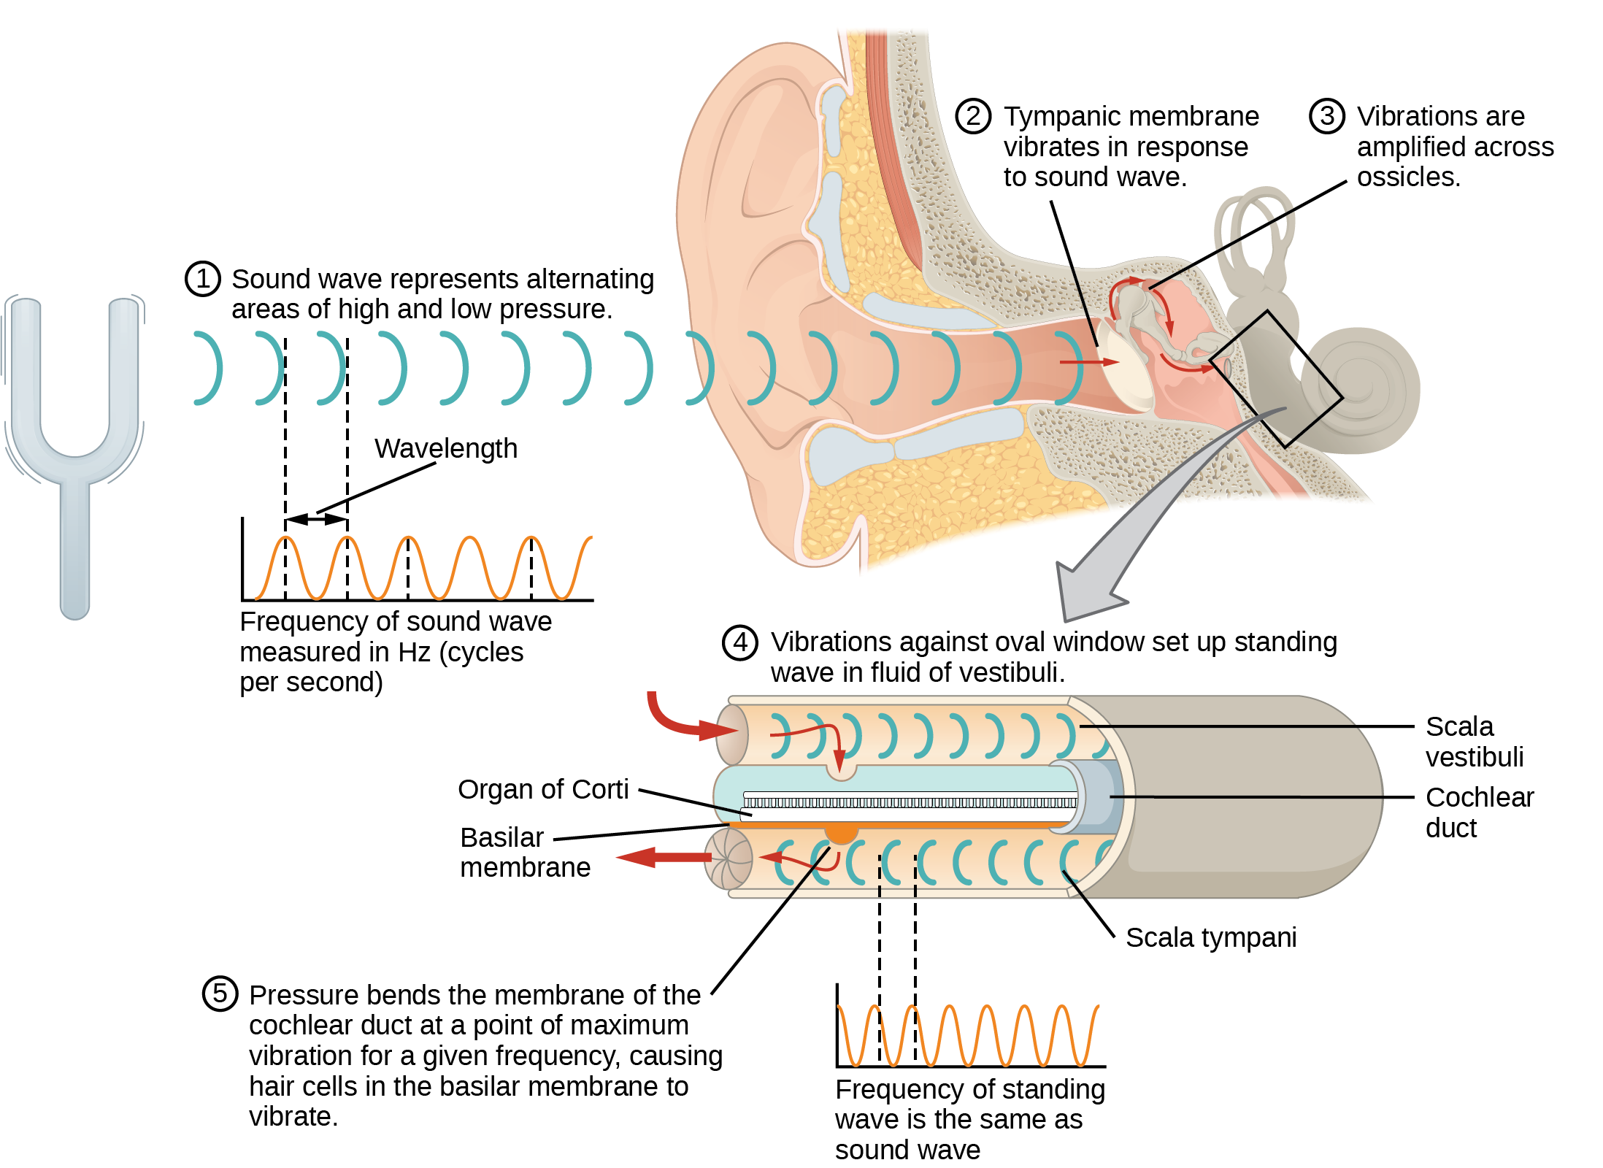
SOUND WAVE TRANSDUCTION
A sound wave causes the tympanic membrane to vibrate.
This vibration is amplified as it moves across the malleus, incus, and stapes.
The amplified vibration is picked up by the oval window causing pressure waves in the fluid of the scala vestibuli and scala tympani.

Slide 42
HAIR CELLS
The hair cell is a mechanoreceptor with an array of stereocilia emerging from its apical surface.
The stereocilia are tethered together by proteins that open ion channels when the array is bent toward the tallest member of their array, and closed when the array is bent toward the shortest member of their array.

Slide 43
HAIR CELLS AND TRANSDUCTION
Volume (intensity) is determined by the number of hair cells stimulated.
Hair cells respond the best to a small range of frequency but can respond to a broader range if the intensity if great enough.
Hair cells are part of a bipolar neuron that sends impulses through the auditory nerve (collective whole) to the brain.
The auditory system is extremely refined (to the point where signals from the brain can adjust the response of hair cells).

Slide 44
PLACE THEORY
How pitch detection works in humans
High frequency sound selectively vibrates the membrane near the oval window (entrance).
Lower frequencies travel further causing appreciable excitation of the membrane.
There is likely a “sharpening” mechanism present to enhance pitch resolution.

Slide 45
HIGHER PROCESSING
About 90 percent of the afferent neurons carry information from the inner hair cells (other 10 percent from the outer hair cells)
Signals go from the cochlea to the medulla, through the pons and midbrain, finally reaching the primary auditory cortex (within the temporal lobe).

Slide 46
VESTIBULAR INFORMATION
Stimuli include linear acceleration (gravity), angular acceleration, and angular deceleration.
Stimuli detected by evaluating the inertia on receptive cells
Gravity through head positioning
Angular acceleration and deceleration through turning or tilting of the head
Utilizes hair cells (excited differently than the auditory hair cells)
Vestibular receptive organs within the inner ear (vestibular labyrinth)

Slide 47
VESTIBULAR INFORMATION
There are five vestibular receptor organs in the inner ear: the utricle, the saccule, and three semicircular canals.
The roughly 30,000 hair cells in the utricle and 16,000 hair cells in the saccule lie below a gelatinous layer, with their stereocilia projecting into the gelatin.
Embedded in this gelatin are calcium carbonate crystals—like tiny rocks.

Slide 48
VESTIBULAR LABYRINTH
Utricle (around 30,000 hair cells) and saccule (around 16,000 hair cells)
Respond to acceleration in a straight line (such as gravity).
Stereocilia project into a gelatin.
Gelatin contains calcium carbonate crystals.
Shifting gelatin from a tilted head bend the stereocilia causing depolarization.
Vestibular branch of the vestibulocochlear nerve deals with balance.

Slide 49
VESTIBULAR LABYRINTH (CONT.)
Three semicircular canals
Tubular loops set at oblique angles.
Base of each loop contains a swelling with cluster of hair cells.
Hairs project into the cupula (gelatinous cap).
Monitors angular acceleration and deceleration from rotation.
The fluid shifts when the head moves causing stimulation of the stereocilia.
Only senses changes in velocity.

Slide 50
HIGHER PROCESSING
Hair cells communicate via bipolar neurons that send signals to the cochlear nucleus in the medulla.
Cochlear neurons send descending projections to the spinal cord and ascending projections to the pons, thalamus, and cerebellum (important for coordinating movements).
Projections also sent to the temporal cortex (feeling dizzy), autonomic centers in the brainstem (motion sickness), and the primary somatosensory cortex.
Signals also project to certain optic muscles (coordinate eye and head movement).

Slide 51
36.5: VISION
Vision = detect light patterns and interpret into images
Visual systems of species have evolved ways to focus important visual stimuli.
About one-third of human cerebral cortex is dedicated to vision.

Slide 52
LIGHT
Composed of electromagnetic waves
Visible light is only small part of the electromagnetic spectrum
Wavelength determines hue
As wavelength (nm) increases frequency decreases.
Humans perceive light between 380 nm and 740 nm.
Bees can see near-ultraviolet light (nectar guides located on flowers).
Some non-avian reptiles can sense infrared light (heat from prey).

Slide 53
LIGHT (CONT.)
Amplitude determines brightness
1 candela = brightness of one common candle
Visible light arrives at the eye as long (red), medium (green), and short (blue) waves.
You can only see light that is reflected off or transmitted through an object. (Absorbed light cannot be seen.)

Slide 54
THE ELECTROMAGNETIC SPECTRUM
In the electromagnetic spectrum, visible light lies between 380 nm and 740 nm. (credit: modification of work by NASA)

Slide 55
EYE ANATOMY
The photoreceptive cells of the eye are located in the retina on the inner surface of the back of the eye.
The cornea, the front transparent layer of the eye, and the crystalline lens, a transparent convex structure behind the cornea, both refract (bend) light to focus the image on the retina.
The iris is a muscular ring that regulates the amount of light entering the eye.

Slide 56
EYE ANATOMY
The human eye is shown in cross section.
A blowup shows the layers of the retina.

Slide 57
PHOTORECEPTORS
Responsible for transduction of light.
Rods are strongly photosensitive and are located in the outer edges of the retina.
They detect dim light and are used primarily for peripheral and nighttime vision.
Cones are weakly photosensitive and are located near the center of the retina.
They respond to bright light, and their primary role is in daytime, color vision.

Slide 58
RODS AND CONES

Slide 59
FOVEA
Located in the back of the eye
Responsible for acute vision
High density of cones

Slide 60
EYE ANATOMY
The human eye is shown in cross section.
A blowup shows the layers of the retina.

Slide 61
TRANSDUCTION OF LIGHT
(a) Rhodopsin, the photoreceptor in vertebrates, has two parts: the trans-membrane protein opsin, and retinal. When light strikes retinal, it changes shape from (b) a cis to a trans form. The signal is passed to a G-protein called transducin, triggering a series of downstream events.

Slide 62
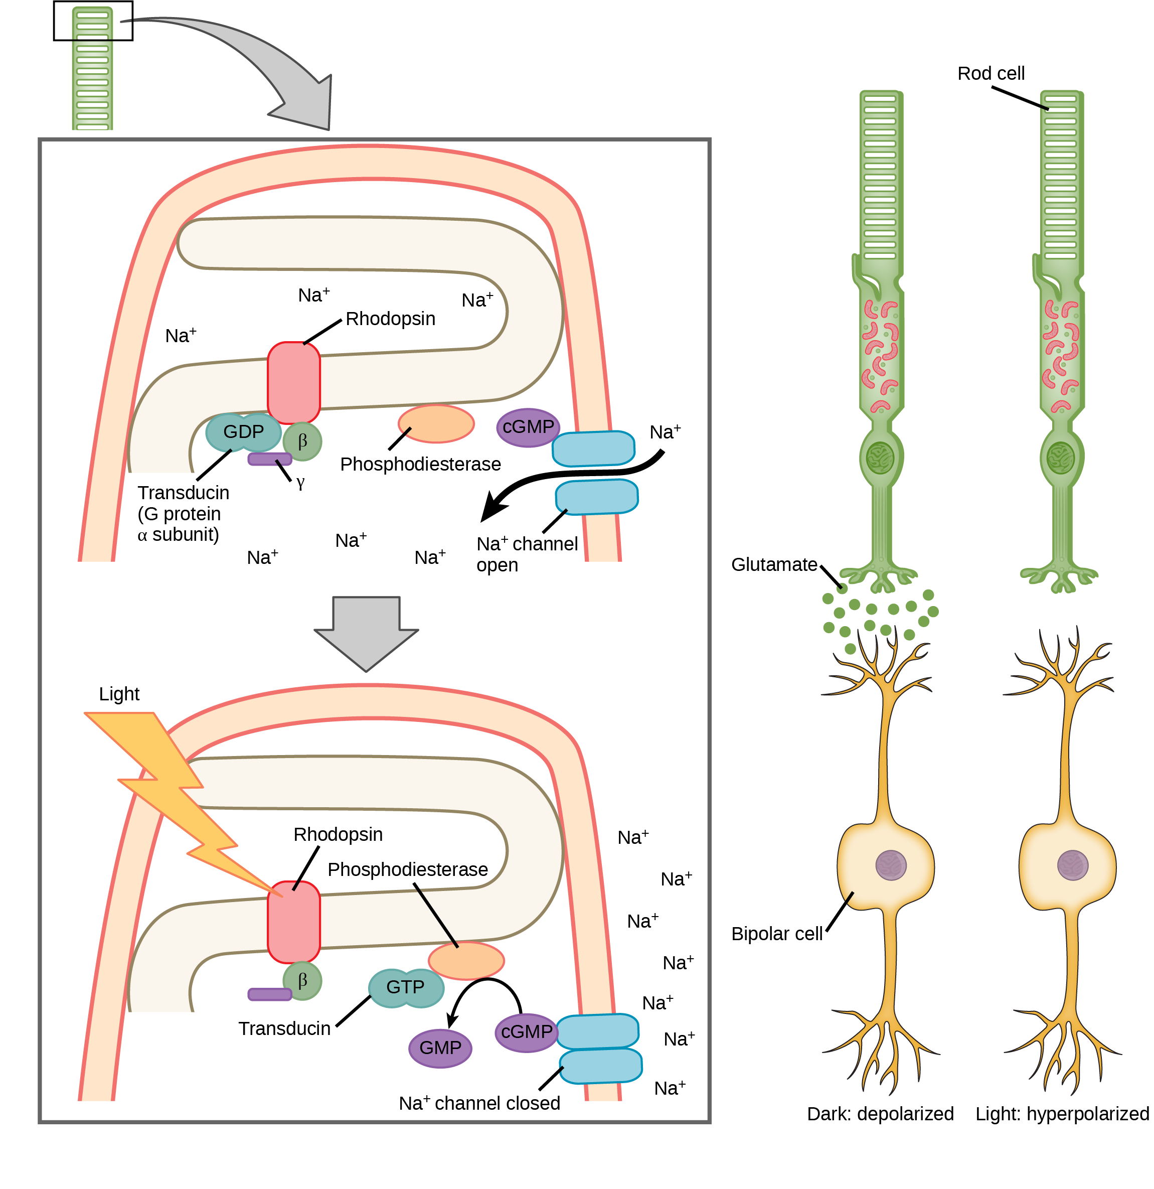
TRANSDUCTION OF LIGHT (CONT.)
When light strikes rhodopsin, the G-protein transducin is activated, which in turn activates phosphodiesterase. Phosphodiesterase converts cGMP to GMP, thereby closing sodium channels. As a result, the membrane becomes hyperpolarized. The hyperpolarized membrane does not release glutamate to the bipolar cell.

Slide 63
TRICHROMATIC CODING
Three types of cones that differ to the wavelength in which they are most responsive to.
S cones (short) = most responsive to 420 nm
M cones (medium) = most responsive to 530 nm
L cones (long) = most responsive to 560 nm
Primates use a trichromatic system (full color vision)
Perceived color results from the ratio of activity from the different cones.
Humans have very sensitive perception (about 2 million distinct colors).

Slide 64
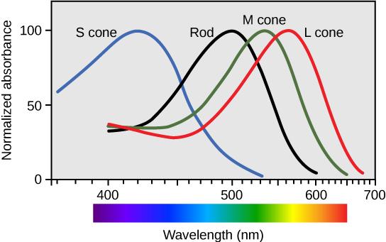
Figure 36.22 Human rod cells and the different types of cone cells each have an optimal wavelength. However, there is considerable overlap in the wavelengths of light detected.

Slide 65
RETINAL PROCESSING
Visual signals leave the photoreceptors and travel through bipolar neurons to ganglion cells.
Some of the visual processing occurs in the retina itself.
Photoreceptors display tonic activity (always slightly active and firing at a baseline rate).
In the absence of light photoreceptors depolarize and release inhibiting signals.
In the present of light photoreceptors hyperpolarize and do not release inhibiting signals.

Slide 66
RETINAL PROCESSING (CONT.)
In the absence of inhibition, the bipolar cells become active and stimulate the ganglion cells. (axons of the ganglion cell leave the eye as the optic nerve)
Lateral inhibition
Horizontal cells can carry signals to different locations.
Rods or cones stimulate a horizontal cell that inhibits more distant photoreceptors.
This can sharpen edges and enhance contrast.

Slide 67
Figure 36.23 View this flag to understand how retinal processing works. Stare at the center of the flag (indicated by the white dot) for 45 seconds, and then quickly look at a white background, noticing how colors appear.

Slide 68
HIGHER PROCESSING
Optic nerve = myelinated axons on ganglion cells
Different axons carry different qualities of the visual signal
Magnocellular (big cell) = information on form, movement, and depth
Parvocellular (small cell) = information on color and fine detail
Optic chiasma = base of brain, crossing of optical pathways

Slide 69
HIGHER PROCESSING (CONT.)
Once in the brain visual information can take multiple pathways
One route goes through the thalamus to the primary visual cortex.
From the cortex signals can go to the parietal lobe (magnocellular information) or the temporal lobe (magnocellular and parvocellular information).
Another pathway goes from the retina to the superior colliculus.
Yet another pathway goes from the retina to the suprachiasmatic nucleus (SCN).

